Slide 1

Working with Audio Part 4 Whisper (Translation)

Slide 2
What We Will Cover
Understanding Translation
Translation Request
Temperature
Segments and Words
Response Formats
Passing the Output

Slide 3
Understanding Translation

Slide 4


Whisper (Speech-to-Text) Translation
Whisper
(Speech-to-Text)
Any Supported Language
English

Slide 5
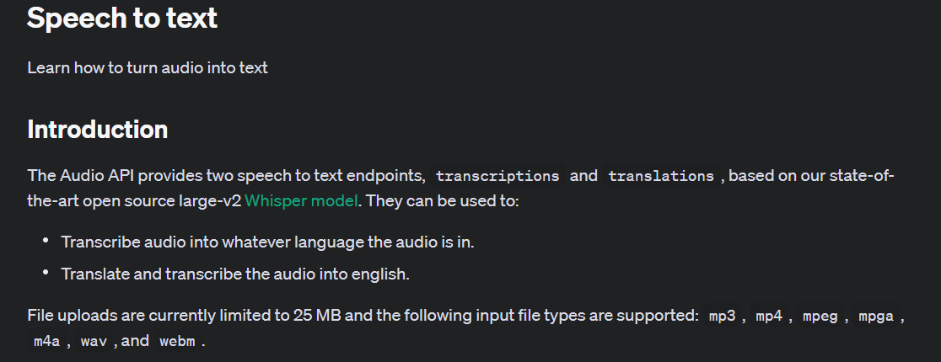
Notes:
https://platform.openai.com/docs/guides/speech-to-text/speech-to-text

Slide 6
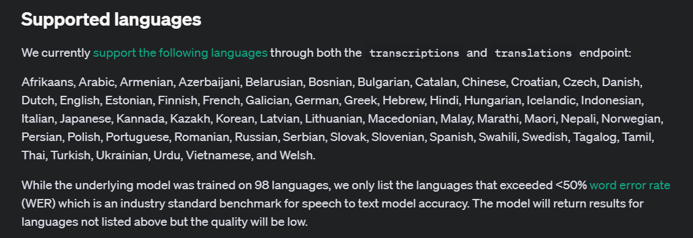
Notes:
https://platform.openai.com/docs/guides/speech-to-text/supported-languages

Slide 7
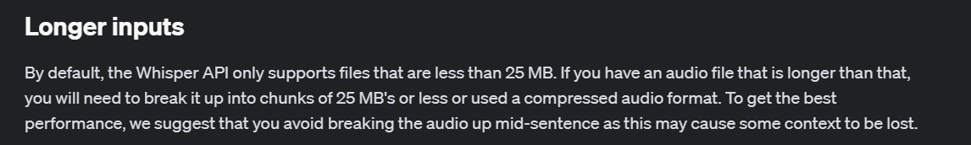
Notes:
https://platform.openai.com/docs/guides/speech-to-text/longer-inputs

Slide 8
Translation Request

Slide 9
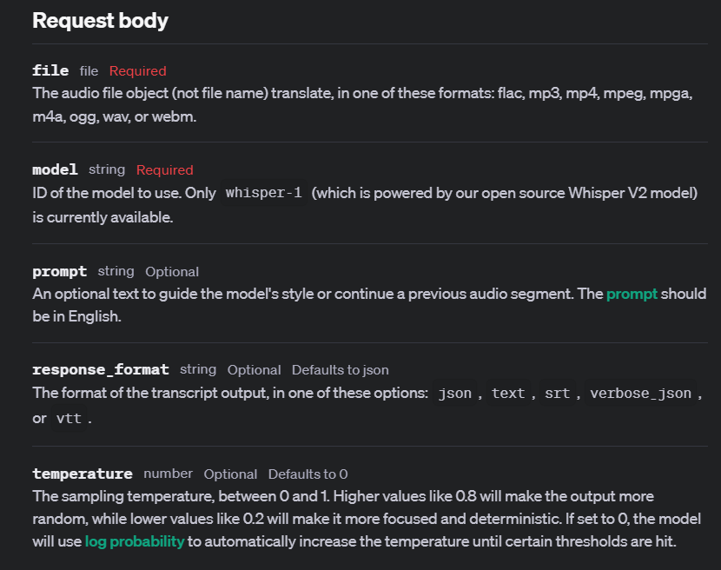
Notes:
https://platform.openai.com/docs/api-reference/audio/createTranslation

Slide 10
Demo: Simple Translation
audio_file = open("./artifacts/japanese_audio_test.mp4", "rb")
transcript = client.audio.translations.create(
model="whisper-1",
file=audio_file
)

Slide 11
Temperature

Slide 12
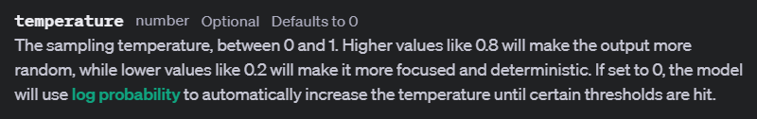
Notes:
https://platform.openai.com/docs/api-reference/audio/createTranscription#audio-createtranscription-temperature

Slide 13
Temperature Examples
Audio Sentence: "Good morning everyone, um, let's get started with our quarterly review. As you can see, the sales figures for Q2 have, uh, significantly improved. However, we still need to address the issues in the supply chain. Any thoughts?"
High Temperature Transcription: "Good morning everyone, let's get started with our quarterly review. The sales figures for Q2 have significantly improved. However, we still need to address the issues in the supply chain. Any thoughts?"(More fluent, less filler words)
Low Temperature Transcription: "Good morning everyone, um, let's get started with our quarterly review. As you can see, the sales figures for Q2 have, uh, significantly improved. However, we still need to address the issues in the supply chain. Any thoughts?" (More literal and detailed)
Dynamic Temperature (0): "Good morning everyone, let's get started with our quarterly review. As you can see, the sales figures for Q2 have significantly improved. However, we still need to address the issues in the supply chain. Any thoughts?"(Balanced, removing unnecessary fillers while maintaining accuracy)

Slide 14
Demo: Using Temperature
audio_file = open("./artifacts/japanese_audio_test.mp4", "rb")
transcript = client.audio.translations.create(
model="whisper-1",
file=audio_file,
temperature=0.1
)

Slide 15



Notes:
https://www.youtube.com/channel/UC35ZpwldGw7ZJ5R-2sLijzw

Slide 16
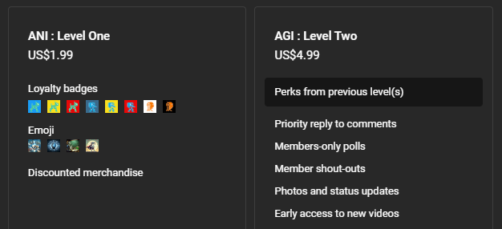

Membership has its privileges
Notes:
https://www.youtube.com/channel/UC35ZpwldGw7ZJ5R-2sLijzw/join

Slide 17

https://www.youtube.com/@AINewsFresh

Slide 18
Segments and Words

Slide 19

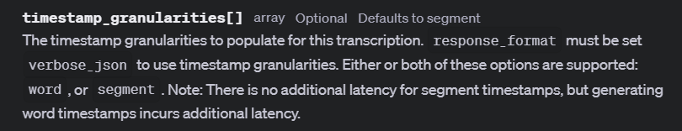
Notes:
https://platform.openai.com/docs/api-reference/audio/createTranscription#audio-createtranscription-timestamp_granularities

Slide 20
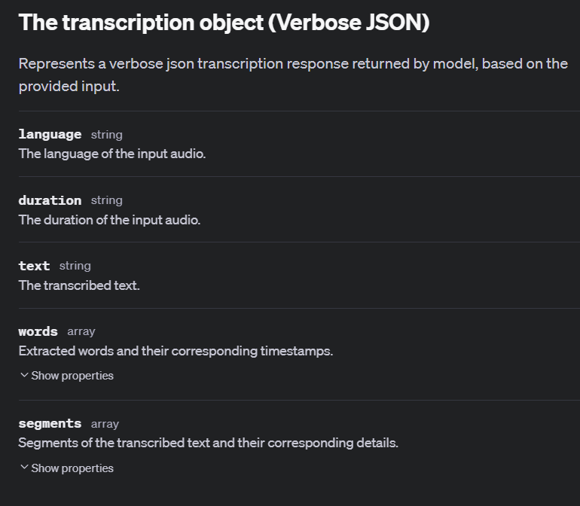
Notes:
https://platform.openai.com/docs/api-reference/audio/verbose-json-object

Slide 21
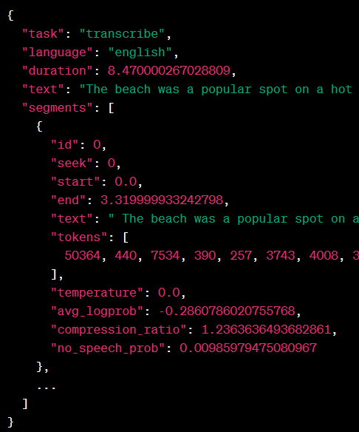
Segment Example

Slide 22
Demo: Segment Timestamps
audio_file = open("./artifacts/japanese_audio_test.mp4", "rb")
transcript = client.audio.translations.create(
model="whisper-1",
file=audio_file,
temperature=0,
response_format="verbose_json",
)

Slide 23
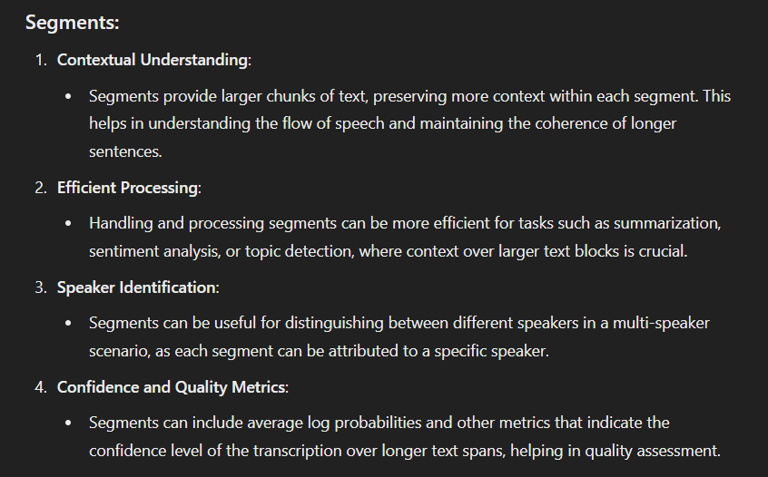
Why Segments?

Slide 24
Response Formats

Slide 25
verbose_json

Slide 26
text
I couldn't study Japanese because of the COVID-19 after I started studying Japanese. Due to the COVID-19, I couldn't take Japanese language test in Belarus. I couldn't do it because there was no such exam. But you can go anywhere now. If you are interested… When I started taking Japanese language school, Is it necessary to take the exam? It's hard to get it. Do you study Japanese in next month? No, in July. So, we can't go there right now. Do you study JLPT in Japanese language school? Yes, I do. I mean, the school says so. Do you have the curriculum? So, you will take the exam for JLPT. Yes. But you don't have to go to Japanese language school. It's a means to live in Japan. To get the student visa.

Slide 27
Demo: text format
audio_file = open("./artifacts/japanese_audio_test.mp4", "rb")
transcript = client.audio.translations.create(
model="whisper-1",
file=audio_file,
temperature=0,
response_format="text",
)

Slide 28
srt (SubRip Subtitle)
1
00:00:00,000 --> 00:00:02,000
I couldn't do it.
2
00:00:02,000 --> 00:00:08,000
After I started studying Japanese,
3
00:00:08,000 --> 00:00:14,000
COVID-19 started immediately.
4
00:00:14,000 --> 00:00:16,000
Because of COVID-19,
5
00:00:16,000 --> 00:00:24,000
I couldn't take the Japanese language test in Belarus.

Slide 29
Demo: srt (SubRip Subtitle) format
audio_file = open("./artifacts/japanese_audio_test.mp4", "rb")
transcript = client.audio.translations.create(
model="whisper-1",
file=audio_file,
temperature=0,
response_format="srt",
)

Slide 30
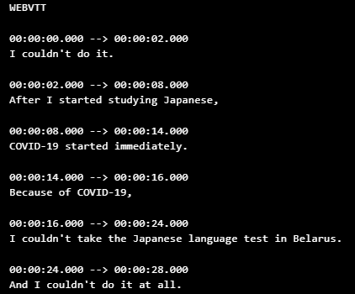
vtt (Web Video Text Tracks)

Slide 31
Passing the Output

Slide 32
Feeding Generated Output to Something Else
Whisper
(Speech-to-Text)
Chat Completion

Slide 33
Demo: Passing the Output
response = client.chat.completions.create(
model="gpt-4o",
temperature=1,
messages=[
{
"role": "system",
"content": "You will be given a translation of an audio file. Your task is to look at it and give me the context you think it is in."
},
{
"role": "user",
"content": translation
}
]
)

Slide 34
